Slide 1
Chapter 2
Creating and Editing Data

Slide 2
Learning Objectives
Explain how to create data set in the IBM SPSS Data Editor
Describe the methods to enter variables and data in the SPSS Data Editor
Explain the procedure to manage missing values in a data set
Demonstrate and explain the steps to create a multiple-response data set in SPSS
Describe the frequency analysis and cross-tabulation for the multiple-response data set

Slide 3
Explain the process to compute the summated score for metric variables
Demonstrate and explain the procedure for recoding the variables into different variables depicting rank order, range, and highest and lowest categories in SPSS
Describe the process for the reverse coding system for negative word statements measured at the Likert scale
Demonstrate the steps used for importing data in SPSS from other major sources

Slide 4
Creating SPSS Data Set
Entering Variables
Each variable is required to assign name, type, width, decimal, label, values, missing value, columns, alignment, measures and role.
Identify the number of variables Identify the scale of measurement Type the name of the first variable Select the type of the variable Assign width | Assign the value for decimal Use label Assign values Assign missing value Assign column width Alignment Select measure

Slide 5
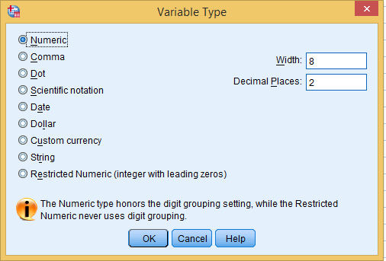
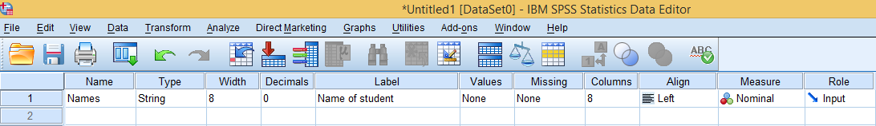
Dialog Box for Type of Variable
IBM SPSS Statistics Data Editor: Variable View

Slide 6
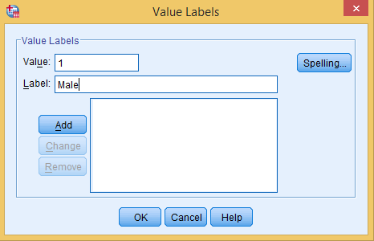
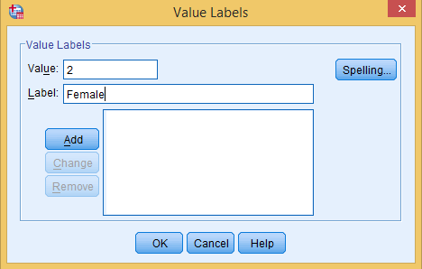
Assigning Values
Exhibit 2.1. Click Values » The Value Labels box appears » Type 1 in the value option » Type Male in the Label box » Click Add » Type 2 in the value option » Type Female in the Label box » Click Add » OK
Figure 2.1a. Data Editor: Value Labels (Category 1)
Figure 2.1b. Data Editor: Value Labels (Category 2)

Slide 7
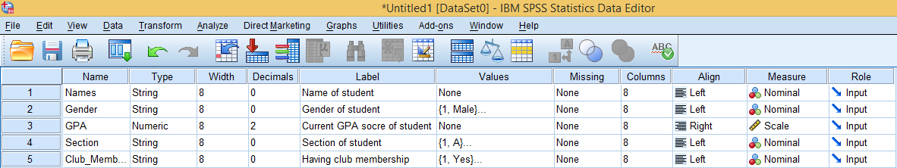
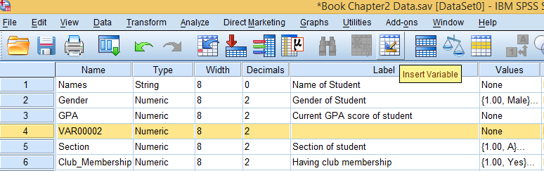
Assigning Variables
Adding Variables in Data Set

Slide 8
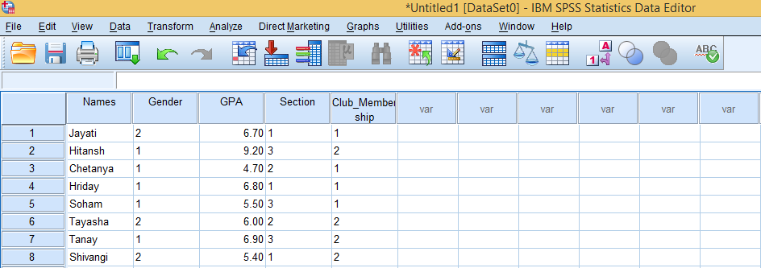
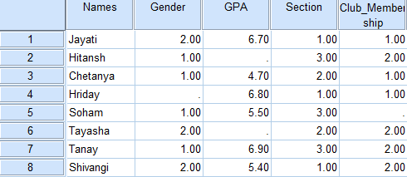
Entering Data
Missing Values in Data Set
1. Particular cell(s) should be left blank in data view

Slide 9
2. Fill empty cells with any number (not occurring in the data set).
Exhibit 2.2. SPSS Statistics Data Editor » Transform » Recode into Same Variables » Transfer all four variables (except names) into Variable box » Click Old and New Values » Select System-or-user missing option » Write any number (not occurring in your data) in Value option » Click on the Add button » Continue » Click OK (recode into same variable box)

Slide 10
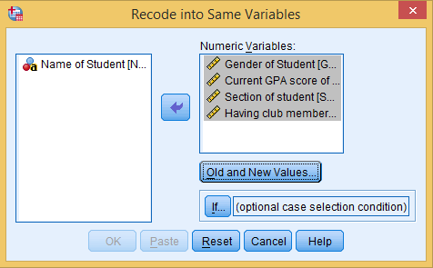
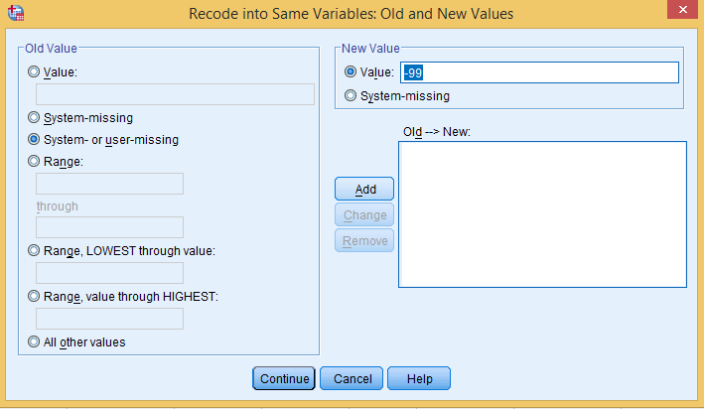
Figure 2.2a. Dialog Box: Recode
Variable
Figure 2.2b. Recoding Variable: Old and New Values

Slide 11
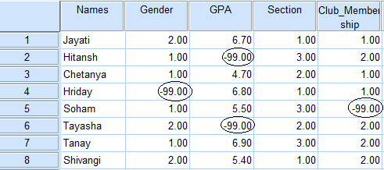
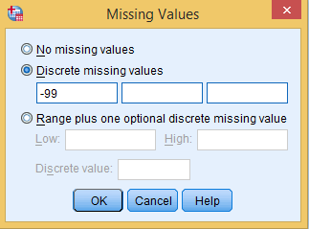
3. All the blank cells are placed with the new value (–99).
4. Assign the missing value for each variable in the data set.

Slide 12
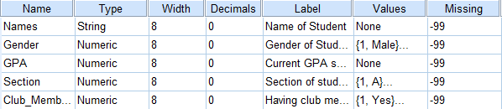
The following data set appears in the Data Editor consisting the missing values (–99) for all the variables.
Sum: Missing Values
It is important to note that the missing values (–99) as assigned to gender for Case 4 (Hriday), GPA for Case 2 (Hitansh) and 9 (Tayasha) and club membership for Case 5 (Soham) do not affect the analysis.
Statistics
Current GPA score of a student
N | Valid | 6
 | Missing | 2
Sum |  | 36

Slide 13
Creating a Multiple-response Set
Multiple-response sets are required in the questions, where respondents are required to give answers for more than one option among the provided options.
Question: Are you aware of these luxury brands mentioned below?
Brand(s) | Yes | No
Prada
Gucci
Hermes
Chanel
Louis Vuitton

Slide 14
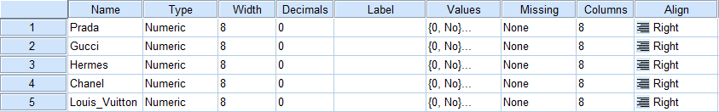
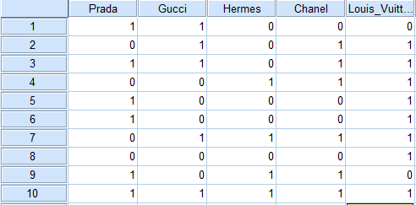
1. Prepare SPSS Data Editor sheet
2. Prepare Data view

Slide 15
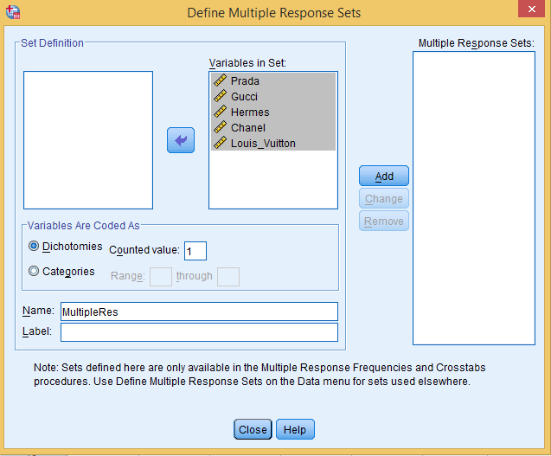
3. Generate multiple-response data sets
Exhibit 2.3. SPSS Statistics Data Editor » Analyse » Define Multiple-response Set » Transfer all five variables into Variable in Set box » Select the Dichotomous option in Variables Are Coded As » Type 1 in Counted Value box » Type MultipleRes in Name » Click on the Add button » Close

Slide 16
Computing Frequency Analysis with Multiple-response Sets
Exhibit 2.4. SPSS Statistics Data Editor » analyse » Define Multiple-response Set » Frequency » Multiple Response Frequencies box » Select $MultipleRes and transfer to the Table(s) box » Click OK
Table 2.1. Frequency Analysis: Multiple-Response Set
 |  | Responses |  | % of Cases
 |  | N | %
$MultipleResª | Prada | 6 | 20.7 | 60.0
 | Gucci | 5 | 17.2 | 50.0
 | Hermes | 4 | 13.8 | 40.0
 | Chanel | 6 | 20.7 | 60.0
 | Louis_Vuitton | 8 | 27.6 | 80.0
Total |  | 29 | 100.0 | 290.0

Slide 17
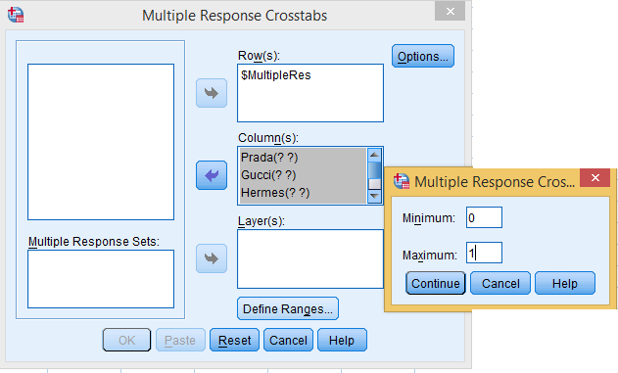
Cross-Tabulation with Multiple-response Sets
Exhibit 2.5. SPSS Statistics Data Editor » analyse » Define Multiple-response Set » Cross-tabulation » Multiple-response Crosstabs » Select $MultipleRes and transfer to the Row(s) box » Select all the variables and transfer to the Column(s) box » Click Define Ranges » Type 0 and 1 in Minimum and Maximum boxes » Continue » OK

Slide 18
Table 2.2. Cross-Tabulation: $MultipleRes and Prada
 |  |  | Prada |  | Total
 |  |  | No | Yes
$MultipleResª | Prada | Count | 0 | 6 | 6
 | Gucci |  | 2 | 3 | 5
 | Hermes |  | 2 | 2 | 4
 | Chanel
 |  |  | 3 | 3 | 6
 | Louis_Vuitton |  | 4 | 4 | 8
Total |  | Count | 4 | 6 | 10
It can be seen that total six respondents mentioned ‘Yes’ option for Prada. Further, we can see that two respondents mentioned ‘No’ for both Gucci and Prada, and three mentioned ‘Yes’ for these brands.

Slide 19
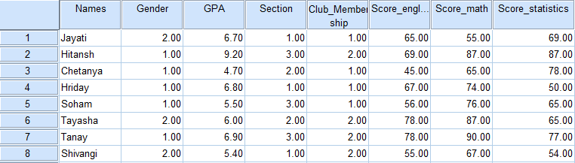
Summated Score
The variables measured at interval or ratio scale can be used to compute the summated score as per the requirement of the analysis and covered into a specific variable presenting the summated value. Variables are shown below.

Slide 20
Exhibit 2.6. Exhibit 2.6 SPSS Statistics Data Editor » Transform » Compute Variable » Compute Variable Box » Type a name of new variable – mean_score in Target Variable Box » Select statistical in the Function Group » Select mean as special variable » Select all three variables (one-by-one and separated by comma) and transfer to Numeric Expression Box » Click on arrow » Press OK

Slide 21
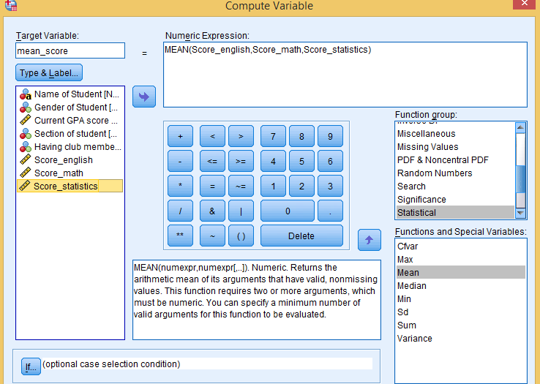
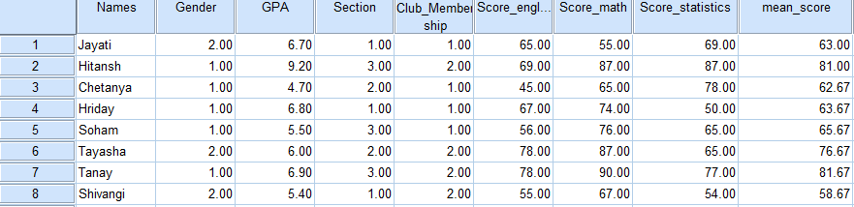
One new variable mean_score appears automatically as a new variable in the variable view. The average score of the three variables (score of English, math and statistics) is computed by the software.

Slide 22
Recode Variable
Recode into Rank Order
Exhibit 2.7. SPSS Statistics Data Editor » Transform » Recode into Different variables » Select GPA and transfer into Input-Output variable Box » Type Name and Label of Output Variable (as GPA_Rank) » Click Change » Click Old and New Values » Type highest GPA 9.2 in Value Box as old value option » Type 1 in Value Box as New Value Box » Click Add (Repeat the same steps for all other GPA Scores) Continue » Ok

Slide 23
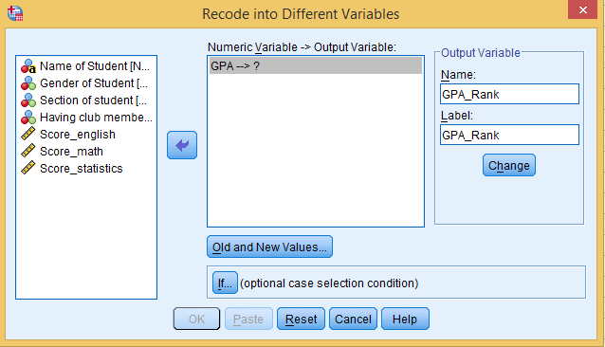
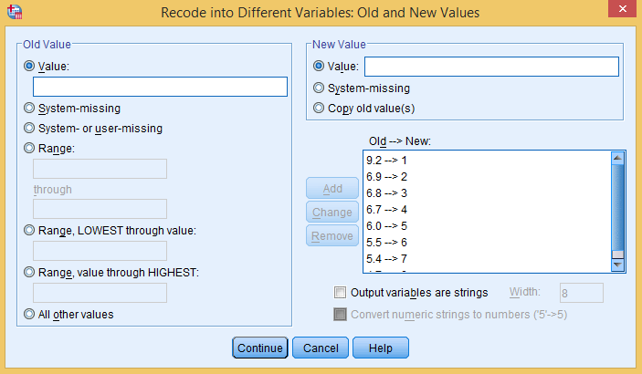
Figure 2.3a. Main Dialog Box: Recoding
Figure 2.3b. Recoding: Rank Order

Slide 24
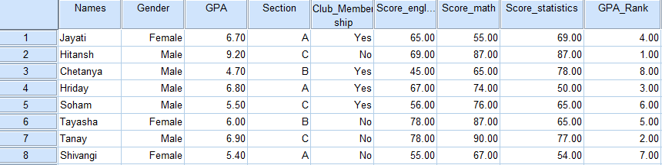
A new variable, GPA_Rank, automatically appears in Data Editor window at the last column (9th column) and can be seen at Variable View.

Slide 25
Recode for a Particular Range
Exhibit 2.8. SPSS Statistics Data Editor » Transform » Recode into Different variables » Select Score_english and transfer into Input-Output variable Box » Type Name and Label in Output Variable box (as New_Score_English) » Click Change » Click Old and New Values » Click on Range in old value option » Type 45 in Range box and 50 in the through box » assign 1 in as new value Box » Click Add (Repeat the same steps for all other range values of English score) Continue » Click Ok

Slide 26
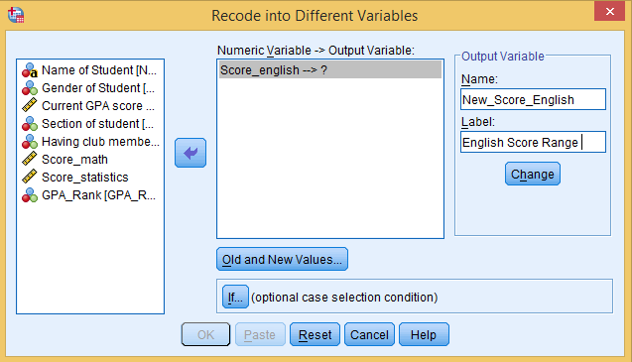
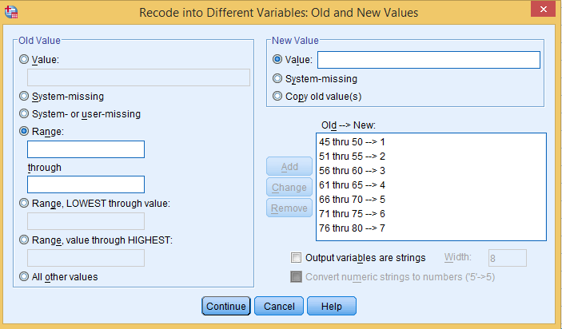
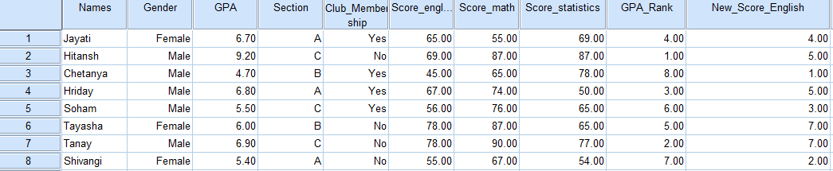
Figure 2.4a. Main Dialog Box: Recoding for Range
Figure 2.4b. Recoding: Range Values
A new variable New_Score_English automatically appears in Data Editor window at the last column (10th column).

Slide 27
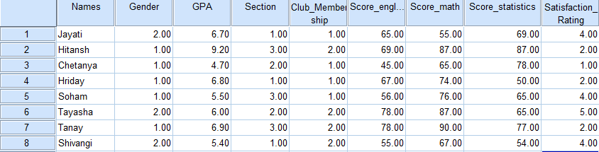
Recoding for Highest and Lowest Categories
File is shown below.
Exhibit 2.9. SPSS Statistics Data Editor » Transform » Recode into Different variables » Select Satisfaction_Rating and transfer into Output variable Box » Type Name and Label of Output Variable (as Categories _Satisfaction) » Click Change » Click Old and New Values » Click on Range » Type 3 in the Range, LOWEST through value in old value option » Click on output variables are string » Type Dissatisfaction in option new value » Click on Add » Type 4 in the Range, Highest through value » Type satisfaction in the option New value » click on Add » press continue » press Ok

Slide 28
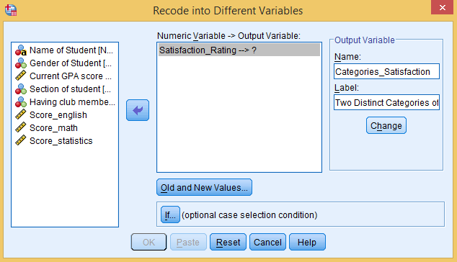
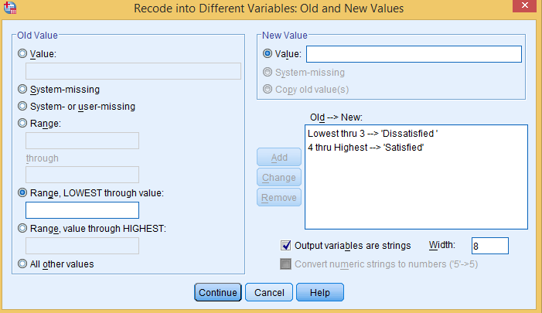
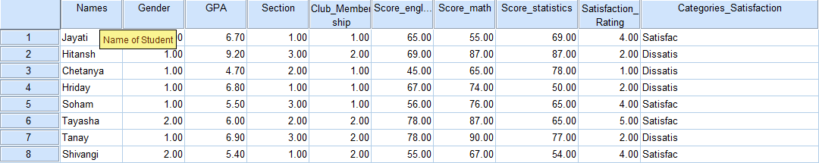
Figure 2.5a. Main Dialog Box: Recoding Highest and Lowest Categories
Figure 2.5b. Recoding: Old and
New Values
A new variable Categories_Satisfaction automatically appears in Data Editor window at the last column (10th column).

Slide 29
Reverse Coding
Reverse coding is an important application executed with SPSS to code and analyse the responses of negative statements simultaneously along with non-negative items.
New Rating Score = (Highest Score in Likert Scale + 1) − Original Rating Score
Table 2.3. Statements: Global Self-Worth Scale
Statements (1 to 5) of General Feeling | Rating
On the whole, I am satisfied with myself | 4 | 3 | 2 | 1
2. At times, I think I am no good at all | 4 | 3 | 2 | 1
3. I feel that I have a number of good qualities | 4 | 3 | 2 | 1
4. I feel I do not have much to be proud of | 4 | 3 | 2 | 1
5. I take a positive attitude towards myself | 4 | 3 | 2 | 1

Slide 30
Table 2.4. Reverse Coding: Negative Statements
Original Rating Score for positive statements | 4 | 3 | 2 | 1
Reverse Rating Score for negative statement | 1 | 2 | 3 | 4

Slide 31
Exhibit 2.10. SPSS Statistics Data Editor » Transform » Recode into Different variable » Select S2 and transfer into Numeric variable-Output variable Box » Type Name and Label in the Output Variable (as Reverse_S2and Reverse Coding, resp) »Click Change » Click Old and New Values » Type 4 in Value box as old value option » Type 1 in Value Box as New Value Box » Click Add (Repeat the same pattern for others scores like 3 and 2 in old value and 2 and 3 for new box respectively) » Continue » Ok Same steps also required for generating reverse scores for statement S4

Slide 32
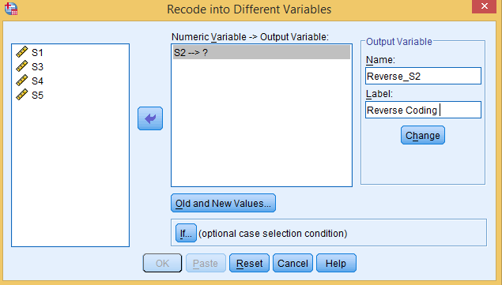
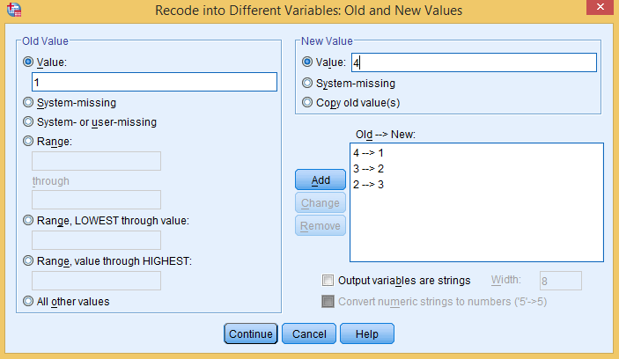
Figure 2.6a. Main Dialog Box: Recoding (Reverse Coding)
Figure 2.6b. Reverse Coding: Old and New Values

Slide 33
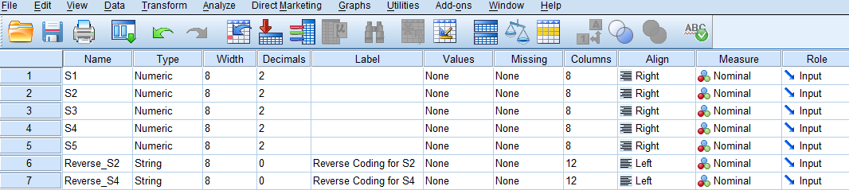
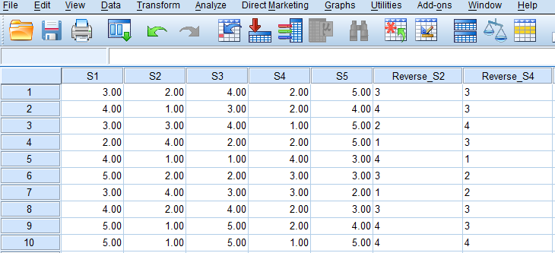
The new variables Reverse_S2 and Reverse_S3 automatically appear in the Data Editor window and can be observed at Variable view as 6th and 7th variables.
Data View

Slide 34
Checklist of Final Data Set for Analysis
Important Checklist Points
1. Naming of variable
2. Examine variable type
3. Identifying the scale of measurement
4. Sequence of variable
5. Examine proper coding
6. Trace missing value(s)
7. Entry of multiple-response items
8. Generated summated score
9. Identifying the need of recoding
10. Applying reverse coding

Slide 35
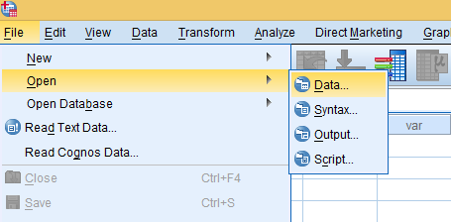
Importing Data from Other Sources
Opening Data Editor
Exhibit 2.11. Blank SPP Data Editor » File » Open » Data
Locating Excel Data Sheet
Exhibit 2.12. Select Excel (*.xls, *.xlxs, *.xlsm) as File type from drop down list » Select Desktop at Look in box » Select Particular Excel File as saved on desktop » Open

Slide 36
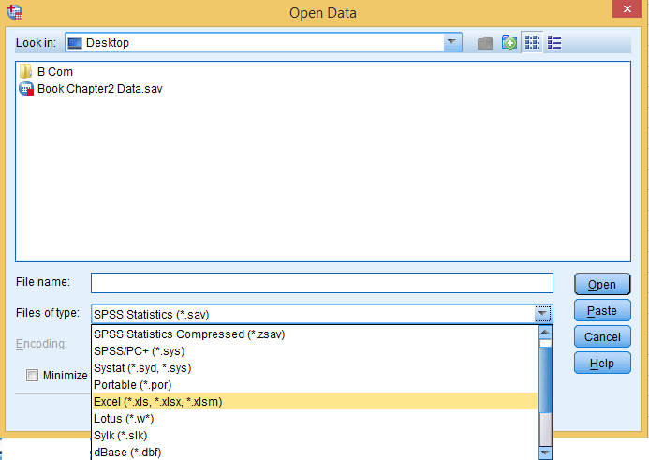
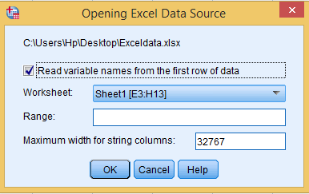
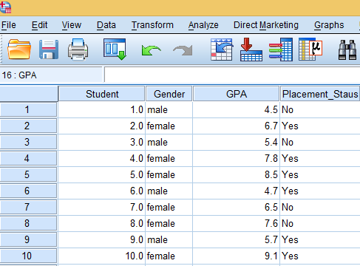
Opening Excel Data Source
Figure 2.7a. Main Dialog Box:
Open Excel Data
Figure 2.7b. Data View:
Import Data

Slide 37
Assigning Codes to Categories
The next step is used to assign the numeric codes to distinct categories of these variables (male/female and yes/no) in SPSS Data Editor.
Exhibit 2.13. SPSS Statistics Data Editor » Transform » Recode into Same variables » Select Gender and transfer into String variables box » Click Old and New Values » Type male (category of variable as mentioned in data) in old value Box » Type 1 (the numeric code for the category) in new Value Box » Click Add (Similarly, use same process for Female category) » Continue »Ok Repeat this process to assign numeric codes for distinct categories of other variables

Slide 38
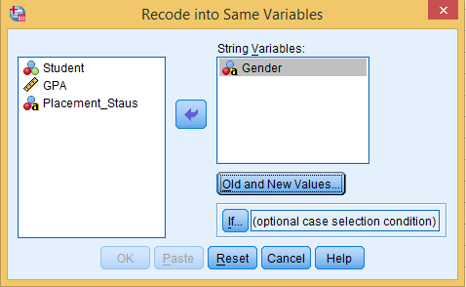
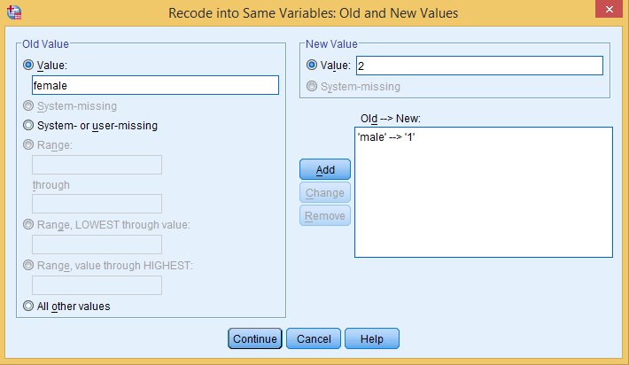
Figure 2.8a. Dialog Box: Recoding Same Variable
Figure 2.8b. Dialog Box: Old and New Values

Slide 39
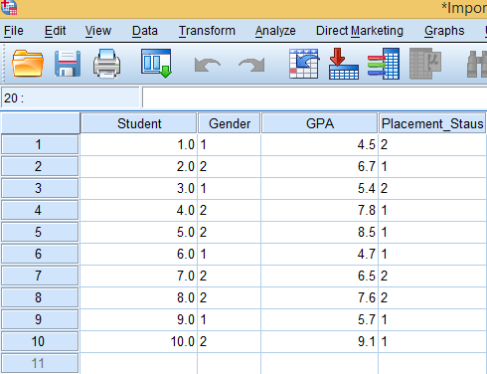
The SPSS Data Editor contains the same variables with specific numeric codes of distinct categories of Gender and Placement_Status.
Weight Case Command
Therefore, in this situation, we use weight case command for frequency count in a large data set. By using this command, the combination of score represents the frequency count of that respective variable without assigning the exact number of rows as required.

Slide 40


Exhibit 2.14. Open SPSS Data Editor » Variable View » Create male and female as two variables in rows 1 and 2 » Data view » Type 400 in column male and 800 in column female

Slide 41
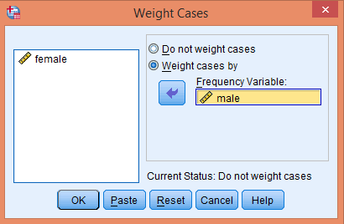
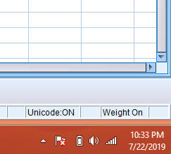
Apply weight case
Exhibit 2.15. Select option Weight cases by » Select male and transfer in Frequency Variable box » Click OK
Figure 2.39a. Weight Case: Main Dialog Box
Figure 2.39b. Indication of Command

Slide 42
Implication of Weight Case Command
Table 2.5. Frequency Table: Weight Case
Gender | Cooking Skill
 | Good | Poor
Male | 150 | 750
Female | 550 | 120
Without using weight case
Table 2.6. Cross-Tabulation: Without Weight Case
gender * cooking_skill
Count
 |  | Cooking_Skill |  | Total
 |  | Good | Poor
Gender | Male | 1 | 1 | 2
 | Female | 1 | 1 | 2
Total |  | 2 | 2 | 4

Slide 43
Table 2.7. Cross-Tabulation: With Weight Case
gender * cooking_skill
Count
 |  | Cooking_Skill |  | Total
 |  | Good | Poor
Gender | Male | 150 | 750 | 900
 | Female | 550 | 120 | 670
Total |  | 700 | 870 | 1570
Using Weight Case Command

Slide 44
Key Terms
Cross tabulation Data editor Data view Likert scale Metric data Missing values Multiple response data set | Nominal Ordinal Range Rank order Reverse coding Scale Summated score Variable view

